Slide 1
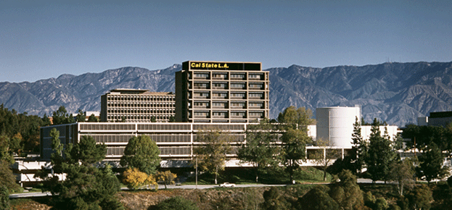
CEEDAR Innovations and Collaboration in the
Cal State LA Charter College of Education :
Moving Towards Institutionalization...
GOAL: to increase faculty collaboration across existing professional preparation programs in Curriculum and Instruction, Special Education, and Educational Administration

Slide 2
Task 1: to provide opportunities for inter-divisional discussions focused on social justice, equity, and inclusiveness of ALL students
Regular Joint Division Meetings
Trouble shoot common concerns like RICA preparation/intervention for candidates who struggle to pass RICA
Discuss CTC Special Education Task Force recommendations; Draft credential models; Proposed TPEs
Retreat to discuss vision for coursework for dual multiple subjects/special education credential program
Discuss Fieldwork Options and Models
(E-supervision with Cal State TEACH)

Slide 3
Institutionalization Efforts:
Endowed Chair presentations by scholars during fall and spring terms for faculty and students from general education, special education and administration
Mary Falvey
Marleen Pugach
Russell Skiba
Chris Kleiwer

Slide 4
Task 2: Identify potential collaborative courses/co-teaching and teaching teams
Mini-grants to encourage Co-Teaching between Division faculty
Reading, Language Development, Fieldwork
Infusion of UDL, MTSS, and Co-Teaching in coursework
Analysis of Reading, Classroom Management, Language Development, and Instructional Design syllabi across teacher development programs using CEEDAR Innovation Configuration tool

Slide 5
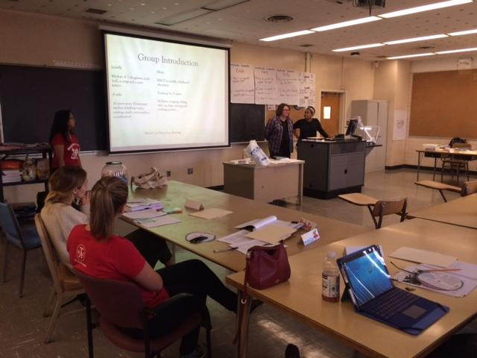
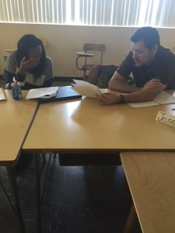
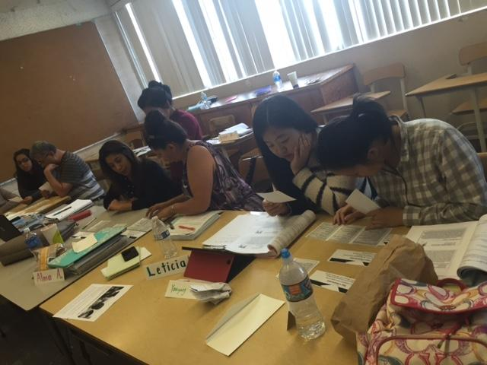
Task 3: Analyze program curricula/courses and field experiences to identify overlapping/complimentary curricula across existing professional programs
Case Study of Collaborative Project: Leila Ricci & Sabrina Mims-Cox
EDCI 549: General Ed--Language Development; ELD Assessment
EDSP 407: Special Ed:--Learning Center; Co-Teaching Models; MTSS/UDL
EDSP 495: Special Ed--Internship Program; MTSS/UDL
Strategies Introduced in Special Ed were ELD Assessment
Strategies Introduced in General Ed were MTSS/UDL/Co-teaching

Slide 6
Implementation Results/Highlights:
ELD Assessments now regular assignment for Special Ed
MTSS/UDL regular part of General Ed Syllabus and Course
Special Ed sites used for Field Placements
Learning Center as Model for Special Ed and Co-Teaching
part of General Ed Syllabus and Course and recommended for collaborative projects
Ongoing collaboration and Co-Teaching among Faculty

Slide 7
Task 4: Develop plan for integrated/merged multiple subjects/special education credential program
Development of 2 credential pathways with infusion of effective special education teaching practices:
Single subject math/science & secondary focus Special education credentials with MA in STEM
Existing General Education and Special Education credential coursework with candidates from both programs enrolled in MA in STEM
Dual multiple subjects/special education credential with MA in STEM
EDSP 400 – Foundations of Special Education + special ed infusion in GE coursework
Combining existing General Education and Special Education coursework
Creating merged coursework with co-teaching of Gen Ed , Spec Ed, Ed Foundations, and Ed Technology faculty; fieldwork placement of gen ed and spec ed credential candidates in inclusive co-taught settings

Slide 8
PD Module Development
Development of online Professional Development Module for faculty to build knowledge of multi-tiered systems of support (MTSS), Universal Design for Learning (UDL) and differentiation.

Slide 10
Cal State LA Charter College of Education
GOAL: to increase faculty collaboration across existing professional preparation programs in Curriculum and Instruction, Special Education, and Educational Administration

